Slide 1
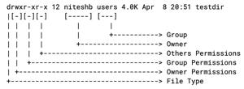
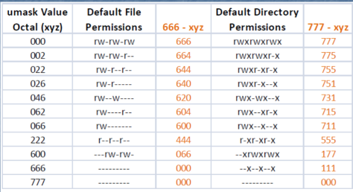

Slide 2
Umask (user file creation mask)
Definition: Umask stands for "user file creation mask." It determines the default permissions given to newly created files and directories in Linux
It controls default permissions for new files & directories
How to check?
-Umask
Root 022
Local user 002 ----------- Numerical permission

Slide 3
Default
Default for files: 666 (rw-rw-rw-)
Default for directories: 777 (rwxrwxrwx)
Umask removes permissions from these defaults: Read (r)4, Write (w)2, Execute (x)1
full permission – umask = File permission
777 – 022 = 755
666 – 033 = 633
Apply to user, group, and others
Example: ls -l shows permissions (e.g., rw-r--r--)

Slide 4

Default Permission: When a user creates a file as a regular user, it’s given permission rw
rw-r-- (664) by default. A directory is given the permission rwxrwxr-x (775). For the root
user, file and directory permission are rw-r--r-- (644) and rwxr-xr-x (755), respectively.
These default values are determined by the value of umask. Type umask to see what your umask value is.
If you ignore the leading zero for the moment, the umask value masks what is
considered to be fully opened permissions for a file 666 or a directory 777.
The umask value of 002 results in permission for a directory of 775 (rwxrwxr-x). That same umask results in a file permission of 644 (rw-rw-r--).

Slide 5
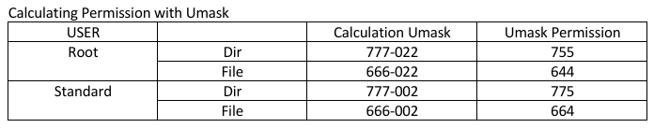
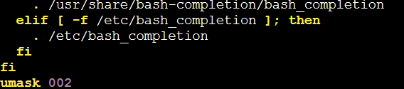
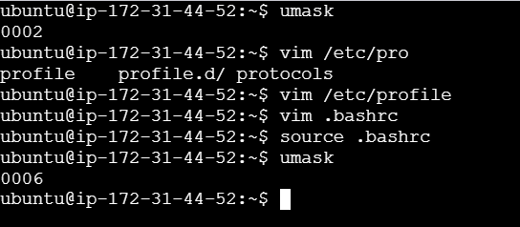
Changing umask value permanent
-Vim .bashrc
-Source .bashrc
-

Slide 6

Read (r) 4
Write (w) 2
Excute (x) 1
Ls –l
Rw-rw-r–
664
Dir
777
Rwxrwxrwx
Umask 002
Defatl file permission777– umask = file permison
666 – 002 = 664
-umask

Slide 7
User adduser
/etc/passwd
/etc/shadow
/etc/group
/etc/gshadow
Mail account
History zsh.history

